Slide 1
Chapter 6 Process Synchronization

Slide 2
教学内容、目标与要求
教学内容
临界区问题
Peterson算法
同步硬件
信号量机制
典型的同步问题
管程
教学重点与难点
重点：1、4、5
难点：4、5
教学目标与要求
理解掌握临界区问题；
理解原子操作；
了解基于软件的临界区问题解决方案；
了解基于硬件的临界区问题解决方案；
掌握用信号量机制实现进程同步控制的方法。

Slide 3
Contents
6.1 Background
6.2 The Critical-Section Problem
6.3 Peterson’s Solution
6.4 Synchronization Hardware
6.5 Semaphores
6.6 Classic Problems of Synchronization
6.7 Monitors

Slide 4
6.1 Background
Processes can execute concurrently.
May be interrupted at any time, partially completing execution.
Concurrent access to shared data may result in data inconsistency.
Maintaining data consistency requires mechanisms to ensure the orderly execution of cooperating processes.
Shared-memory solution to bounded-buffer problem allows at most n-1 items in buffer at the same time.
Suppose we want that all N buffers are used.
adding a integer variable counter, to keep track of the number of full buffers, initialized to 0.
incremented by the producer each time a new item is added to the buffer.
decremented by the consumer each time an item is removed from the buffer.

Slide 5
Bounded-Buffer procedure-consumer problem
Shared data
#define BUFFER_SIZE 10
typedef struct {
…
} item;
item buffer[BUFFER_SIZE];
int in = 0;
int out = 0;
int counter = 0;

Slide 6
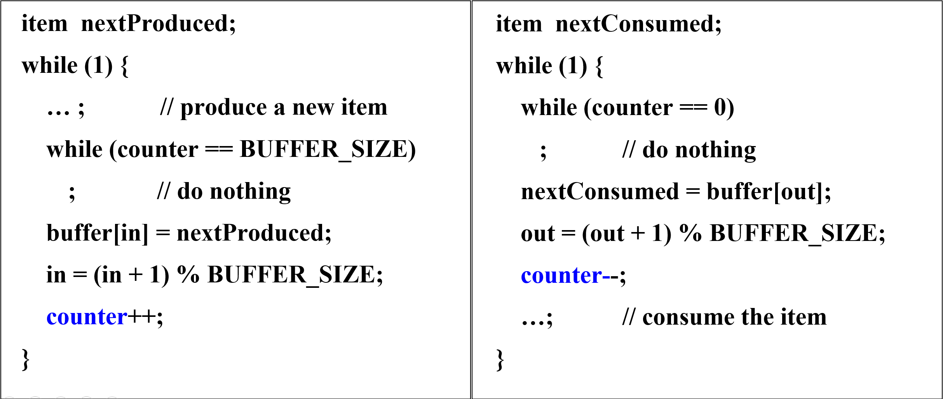
Bounded-Buffer procedure-consumer problem
Producer process
竞争 + 同步
Consumer process

Slide 7
Bounded-Buffer procedure-consumer problem
The statement “ count++ ” may be implemented in machine language as:
register₁ = counter
register₁ = register₁ + 1
counter = register₁
The statement “ count-- ” may be implemented as:
register₂ = counter
register₂ = register₂ – 1
counter = register₂

Slide 8
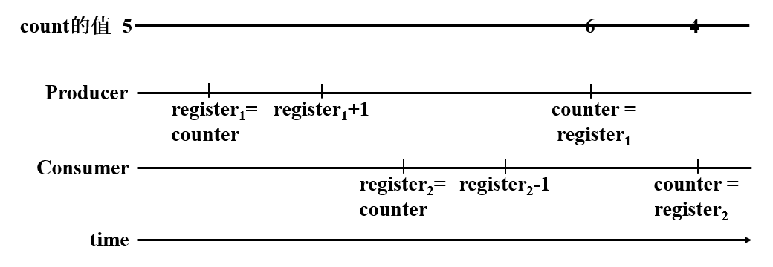
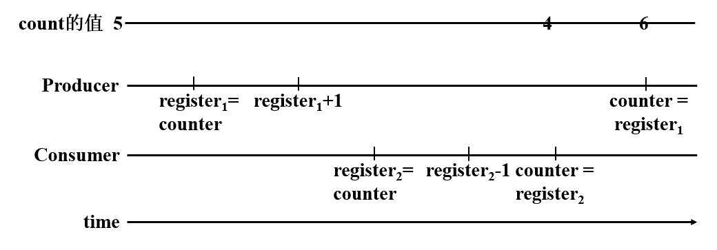
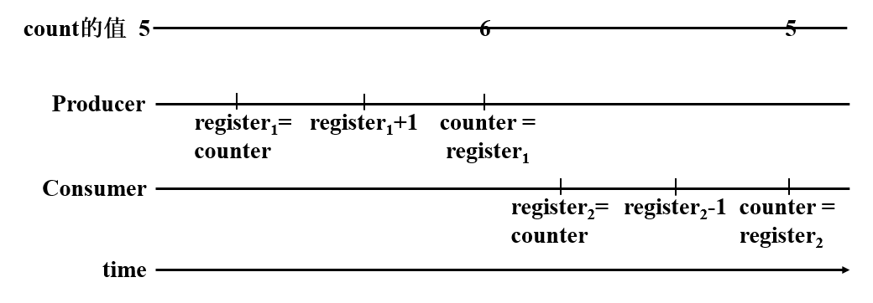
Bounded-Buffer procedure-consumer problem
×
×
√
counter++; / counter--; must be performed atomically.
Atomic operation means an operation that completes in its entirety without interruption.

Slide 9
Race Condition
Race condition: The situation where several processes access and manipulate the shared data concurrently, and the final value of the shared data depends upon the particular order in which the access takes place.
To prevent race conditions, concurrent processes must be synchronized.
有序竞争，安全共享

Slide 10
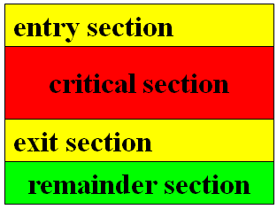
6.2 The Critical-Section Problem
n processes all competing to use some shared data.
Each process has a code segment, called critical section, in which the shared data is accessed.
Problem – – ensure that when one process is executing in its critical section, no other process is to be allowed to execute in its critical section.
Need to design a protocol that the processes can use to cooperate.
Each process must request permission to enter its critical section. The section of code implementing this request is the entry section.
The critical section may be followed by an exit section.
The remaining code is the remainder section.

Slide 11
Solution must satisfy three requirements
1. Mutual Exclusion: If process P_{i} is executing in its critical section, then no other processes can be executing in their critical sections.
2. Progress: If no process is executing in its critical section and there exist some processes that wish to enter their critical section, then the selection of the processes that will enter the critical section next cannot be postponed indefinitely.
3. Bounded Waiting: A bound must exist on the number of times that other processes are allowed to enter their critical sections after a process has made a request to enter its critical section and before that request is granted.
互斥
空闲让进
有限等待

Slide 12
Critical-Section Handling in OS
The code implementing an OS is subject to several possible race conditions.
race conditions in OSs
system open-file-table
structures for maintaining memory allocation, for maintaining process lists, and for interrupt handling
two approaches depending on if kernel is preemptive or non-preemptive.
preemptive – allows preemption of process when running in kernel mode.
difficult to design for SMP architectures, possible for two kernel-mode processes to run simultaneously on different processors.
non-preemptive – runs until it exits kernel mode, blocks, or voluntarily yields CPU.
essentially free of race conditions in kernel mode

Slide 13
Types of solution for critical section
Software: programming
Hardware instructions
TestAndSet
Swap
Semaphores

Slide 14
6.3 Peterson’s Solution
Initial Attempts to Solve Problem
Only 2 processes, P₀ and P₁
General structure of process P_{i} (other process P_{j})
while (1) {
entry section
critical section
exit section
reminder section
}
Processes may share some common variables to synchronize their actions.

Slide 15
Algorithm 1* -- try 1
Shared variables:
int turn; initially turn = 0
turn = i ⇒ P_{i} can enter its critical section
√
特点：被动等待时机
Mutual exclusion?
Progress?
Bounded-waiting?
X
X
Process P₀
while (1) {
while (turn != 0) ;
critical section
turn = 1;
reminder section
}
Process P₁
while (1) {
while (turn != 1) ;
critical section
turn = 0;
reminder section
}

Slide 16
Algorithm 2* -- try 2
Shared variables
boolean flag[2]; initially flag [0] = flag [1] = false.
flag [i] = true ⇒ P_{i} ready to enter its critical section
√
举手示意，文明礼让
Mutual exclusion?
Progress?
Bounded-waiting?
X
X
Process P₀
while (1) {
flag[0] = true; while (flag[1]) ;
critical section
flag[0] = false;
remainder section
}
Process P₁
while (1) {
flag[1] = true; while (flag[0]) ;
critical section
flag[1] = false;
remainder section
}

Slide 17
Algorithm 2* -- try 2+
Shared variables
boolean flag[2]; initially flag [0] = flag [1] = false.
flag [i] = true ⇒ P_{i} ready to enter its critical section
X
Mutual exclusion?
Progress?
Bounded-waiting?
Process P₀
while (1) {
while (flag[1]) ; flag[0] = true;
critical section
flag[0] = false;
remainder section
}
Process P₁
while (1) {
while (flag[0]) ; flag[1] = true;
critical section
flag[1] = false;
remainder section
}

Slide 18
Peterson Algorithm
Combined shared variables of algorithms 1 and 2.
boolean flag[2]={false, false}; // flag[i]=true: P_{i} ready to enter its critical section.
int turn=0; // turn=i: P_{i} can enter its critical section.
Process P_{i}
while (1) {
flag[i]=true; turn=j; while (flag[j] and turn==j) ;
critical section
flag[i]=false;
remainder section
}
举手示意
文明礼让
等待时机
Mutual exclusion?
Progress?
Bounded-waiting?

Slide 19

Peterson Algorithm
Process P₀
Process P₁
while (1) {
flag[0]=true;
turn=1;
while (flag[1] and (turn==1)) ;
critical section
flag[0]=false;
remainder section
}
while (1) {
flag[1]= true;
turn=0;
while (flag[0] and (turn==0)) ;
critical section
flag[1]=false;
remainder section
}
Mutual exclusion?
Progress?
Bounded-waiting?
√
√
√

Slide 20
Bakery Algorithm
Critical section for n processes
Before entering its critical section, process receives a number.
Holder of the smallest number enters the critical section.
If processes P_{i} and P_{j} receive the same number, if i < j, then P_{i} is served first; else P_{j} is served first.
The numbering scheme always generates numbers in increasing order of enumeration; i.e. 1, 2, 3, 3, 3, 3, 4, 5, ...
Notation ‘<’: lexicographical order (ticket #, pid #)
(a, b)<(c, d) if a<c or if a=c and b<d
max(a₀, …, a_{n-1}) is a number, k, such that k≥a_{i} for i = 0, …, n – 1

Slide 21

Bakery Algorithm
P_{i}：
while (1) {
choosing[i] = true; // P_{i} is taking a number
number[i] = max(number[0], number[1], …, number [n–1])+1;
choosing[i] = false; // end of number taking
for (j = 0; j < n; j++) {
while (choosing[j]) ;
while ((number[j] != 0) && ((number[j], j) < (number[i], i)) ;
}
critical section
number[i] = 0;
remainder section
}
排队取号；
排队等待。

Slide 22
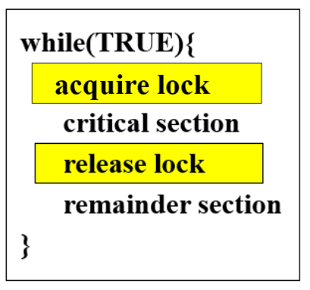
6.4 Synchronization Hardware
Many systems provide hardware support for critical section code.
disable interrupts
Uniprocessors -- currently running code would execute without preemption.
multiprocessor -- too inefficient, time consuming
consider the effect on a system's clock, if the clock is kept updated by interrupts.
A lock -- a simple tool
A process must acquire a lock before entering a critical section;
it releases the lock when it exits the critical section.

Slide 23
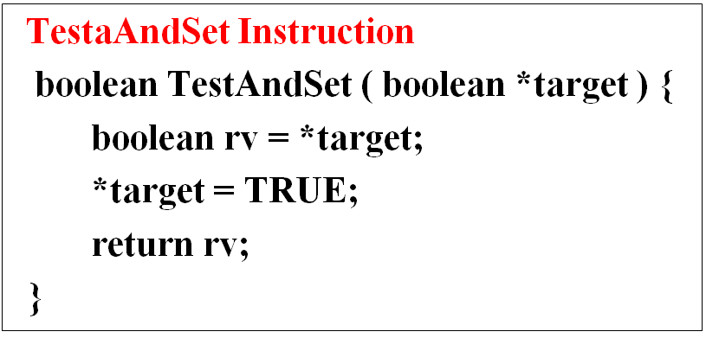
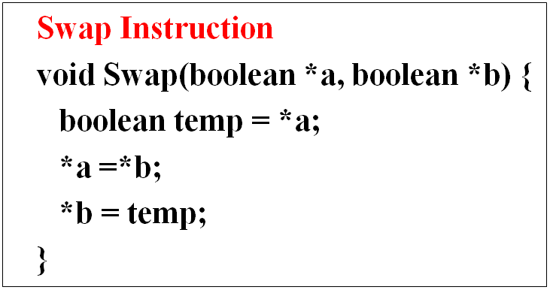
Synchronization Hardware
Modern machines provide special atomic hardware instructions.
atomic = uninterruptible
test memory word and set value TestAndSet()
swap contents of two memory words Swap()

Slide 24

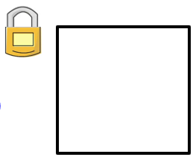
Solution using TestAndSet()
Shared data:
boolean lock = false;
Process P_{i}
while(TRUE) {
while (TestAndSet(&lock))
;
critical section
lock = FALSE;
remainder section
}
√
Mutual exclusion?
Progress?
Bounded-waiting?
√
X
原因：无序竞争！

Slide 25
Solution using Swap()
Shared data:
boolean lock = false;
Process P_{i}
while(TRUE) {
key = true;
while (key == TRUE)
Swap (&lock, &key);
critical section
lock = FALSE;
remainder section
}
√
Mutual exclusion?
Progress?
Bounded-waiting?
√
X
原因：无序竞争！

Slide 26
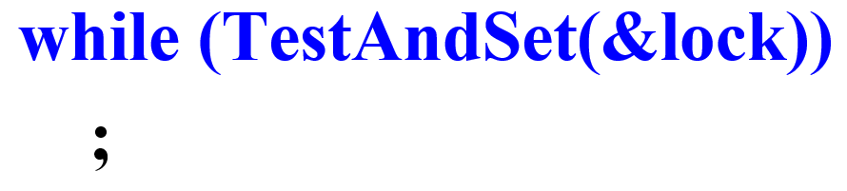
Mutual Exclusion Machine Instructions
Advantages
Applicable to any number of processes on either a single processor or multiple processors sharing main memory.
Simple, easy to verify.
Can be used to support multiple critical sections.
Disadvantages
Busy-waiting consumes processor time.
Starvation is possible when a process leaves a critical section and more than one process is waiting.
Deadlock
If a low priority process has the critical region and a higher priority process needs, the higher priority process will obtain the processor to wait for the critical region.

Slide 27
Revised Solution Using TestAndSet()
Shared data (initialized to false):
boolean lock;
boolean waiting[n];
Process P_{i}
while(TRUE) {
waiting[i] = TRUE; key = TRUE;
while (waiting[i] && key) key = TestAndSet(&lock);
waiting[i] = FALSE;
critical section
j = (i+1) % n;
while (( j != i) && !waiting[j]) j = (j+1) % n;
if (j == i) lock = FALSE;
else waiting[j] = FALSE;
remainder section
}
√
Mutual exclusion?
Progress?
Bounded-waiting?
√
√
有序竞争

Slide 28
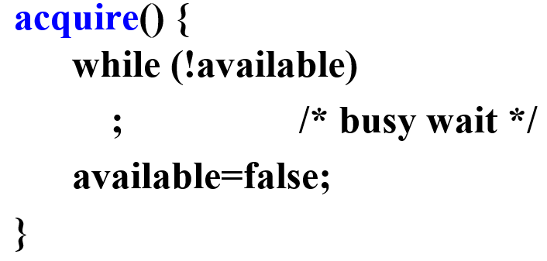
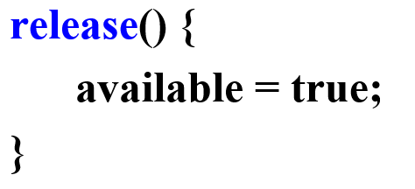
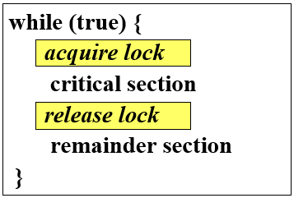
Mutex Locks
Previous hardware-based solutions are complicated and generally inaccessible to programmers.
OS designers build software tools to solve critical section problem.
Simplest is mutex lock (mutual exclusion)
Protect a critical section by first acquire() a lock then release() the lock.
Boolean variable indicating if lock is available or not
Calls to acquire() and release() must be atomic.
Usually implemented via hardware atomic instructions.
But this solution requires busy waiting
This lock therefore called a spinlock
often employed on multiprocessor systems

Slide 29
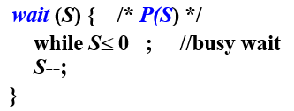
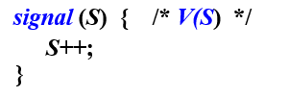
6.5 Semaphores
Synchronization tool that provides more sophisticated ways (than Mutex locks) for process to synchronize their activities.
Does not require busy waiting.
Special variable, Semaphore S – integer variable
Can only be accessed via two indivisible operations
wait(S)
signal(S)
Wait() and signal() operations cannot be interrupted.
Semaphore is a variable that has an integer value
May be initialized to a nonnegative number.
Wait() operation decrements the semaphore value
Signal() operation increments semaphore value

Slide 30
Semaphore usage
Binary semaphore -- integer value can range only between 0 and 1. (Same as a mutex lock )
Counting semaphore -- integer value can range over an unrestricted domain.
Counting semaphores can be used to control access to a given resource consisting of a finite number of instances.
initialized to the number of resources available.
wishes to use a resource, performs a wait() operation.
releases a resource, performs a signal() operation.
When count goes to 0, all resources are being used.
After that, processes that wish to use a resource will block until the count becomes greater than 0.

Slide 31
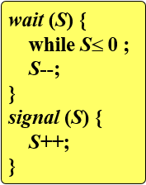
Semaphore usage
Critical Section of n Processes
Shared data:
semaphore mutex; // initially 1
Process Pi:
while (true) {
wait(mutex);
critical section
signal(mutex);
remainder section
}
various synchronization problems.
Consider P₁ and P₂ , require: Action₁ to happen before Action₂
Create a semaphore “synch” // 0
P₁: P₂:
Action₁; wait(synch);
signal(synch); Action₂;
Problem: busy waiting!
This type of semaphore is also called a spinlock
the process "spins" while waiting for the lock.

Slide 32
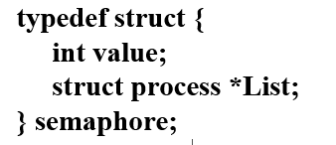
Semaphore Implementation with no Busy waiting
Define a semaphore as a "C" struct:
semaphore S;
Each semaphore has
an integer value
a list of processes list ( an associated waiting queue )
two operations:
block() place the process invoking this operation on the appropriate waiting queue.
wakeup(P) remove one of processes in the waiting queue and place it in the ready queue.
set initial value: 0, 1, n
wait(S)
signal(S)

Slide 33
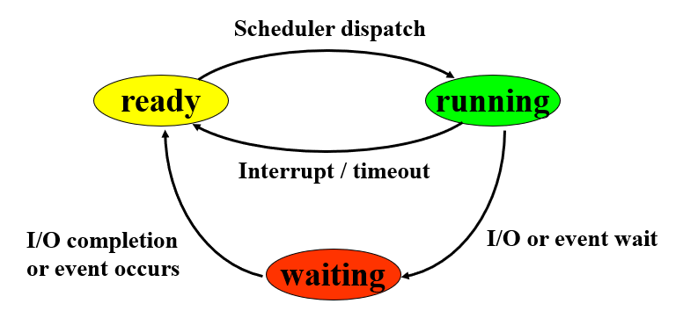
Semaphore Implementation with no Busy waiting
wait (semaphore *S) {
S->value--;
if (S->value < 0) {
add this process to S->List;
block();
}
}
signal (semaphore *S) {
S->value++;
if (S->value <= 0) {
remove a process P from S->List;
wakeup(P);
}
}
Give up CPU to wait!
让权等待！
共享+高效

Slide 34
Semaphore Implementation with no Busy waiting
Must guarantee that no two processes can execute the wait() and signal() on the same semaphore at the same time.
The implementation becomes the critical section problem where the wait() and signal() code are placed in the critical section.
single-processor — inhibit interrupts.
multiprocessor — locking techniques, such as spinlocks.
have not completely eliminated busy waiting.
Have limited busy waiting to the critical sections of wait() and signal() operations.
their implementation code is short, <10 instructions
critical section is never occupied, busy waiting occurs rarely.

Slide 35
Problems: Deadlock and Starvation
Deadlock -- two or more processes are waiting indefinitely for an event that can be caused only by one of the waiting processes.
Let S and Q be two semaphores initialized to 1
P₀ P₁
wait (S); wait (Q);
wait (Q); wait (S);
… …
signal (Q); signal (S);
signal (S); signal (Q);
Starvation -- indefinite blocking. A process may never be removed from the semaphore queue in which it is suspended. ( e.g. a LIFO queue )
P₀: wait (S);
P₁: wait (Q);
P₀: wait (Q);
P₁: wait (S);

Slide 36
Priority Inversion
Example: 3 processes L, M, and H
H requires resource R, which is accessed by L. H wait for L to finish using R. M, runnable, preempting L.
affect how long H must wait for L to relinquish resource R.
Priority Inversion — Scheduling problem when lower-priority process holds a lock needed by higher-priority process.
Solved via priority-inheritance protocol.
All processes that are accessing resources needed by a higher-priority process inherit the higher priority until they are finished with the resources in question.
When they are finished, their priorities revert to their original values.
Solution: L temporarily inherit the priority of H until it finished using R.

Slide 37
6.6 Classica Problems of Synchronization
The Bounded-Buffer Problem
The Readers-Writers Problem
The Dining-Philosophers Problem

Slide 38
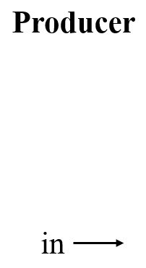
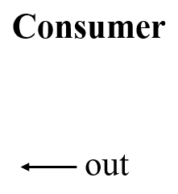
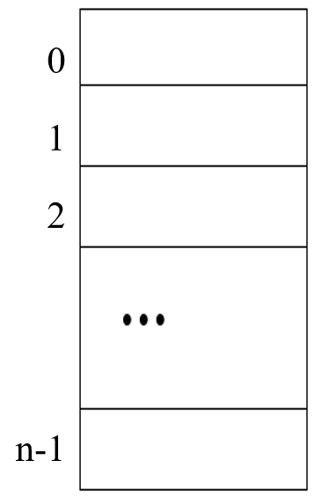
The Bounded-Buffer Problem
Assume the buffer pool consists of n buffers, each capable of holding one item.
Shared data
semaphore mutex, empty, full;
Initially:
mutex = 1
empty = n
full = 0

Slide 39
The Bounded-Buffer Problem
Producer Process Consumer Process
while (1) {
…
// produce an item in nextp
…
…
// add nextp to buffer
…
}
while (1) {
…
/* remove an item from buffer to nextc */
…
…
// consume the item in nextc
…
}
mutex = 1
empty = n
full = 0
wait(full);
wait(mutex);
竞争+合作
相互依存
wait(empty);
wait(mutex);
signal(mutex);
signal(empty);
signal(mutex);
signal(full);

Slide 40
The Readers-Writers Problem
Readers: only read the content of the shared object.
Writers: may update the content of the shared object.
The writers have exclusive access to the shared object.
the first readers-writers problem: reader first
no reader will be kept waiting unless a writer has already obtained permission to use the shared object.
Writers may starve.
the second readers-writers problem: writer first
once a writer is ready, that writer performs its write as soon as possible.
If a writer is waiting to access the shared object, no new readers may start reading.
Readers may starve.
竞争：读-写、写-写
共享：读-读

Slide 41
The 1st Readers-Writers Problem — reader first
竞争：读-写、写-写
共享：读-读
Reader process
…
// reading is performed
…
Shared data
semaphore rw_mutex=1;
semaphore mutex_r=1;
int read_count = 0
wait(mutex_r);
read_count++;
if (read_count == 1)
wait(rw_mutex);
signal(mutex_r);
wait(rw_mutex);
Writer process
…
// writing is performed
…
wait(rw_mutex);
wait(mutex_r);
signal(rw_mutex);
read_count--;
if (read_count == 0)
signal(rw_mutex);
signal(rw_mutex);
signal(mutex_r);

Slide 42
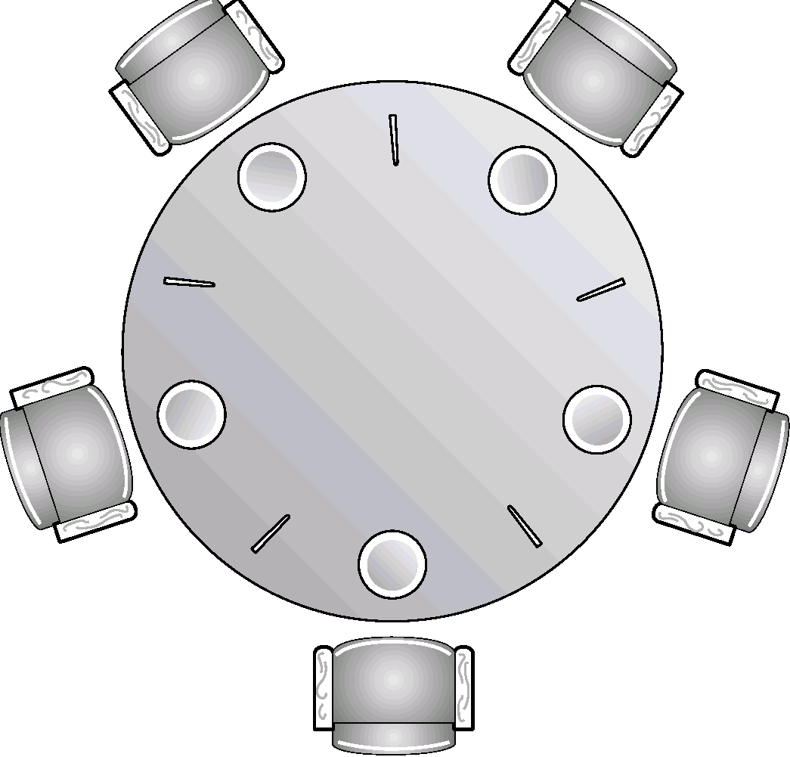
Dining-Philosophers Problem
Philosopher i:
while (1){
hunger
…
eating
…
…
thinking
…
}
4
3
4
0
3
RICE
wait(chopstick[i]);
0
2
wait(chopstick[(i+1) % 5]);
1
2
i
i+1
i
1
signal(chopstick[i]);
临界资源：筷子
signal(chopstick[(i+1) % 5]);
Shared data
semaphore chopstick[5];
Initially all values are 1
死锁?
饿死?

Slide 43
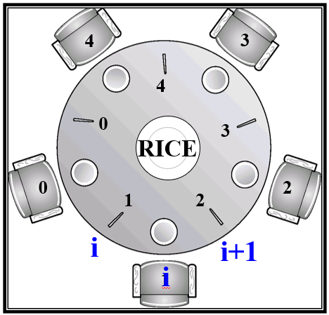
allow at most 4 to be setting simultaneously at the table
semaphore chopstick[5]={1, 1, 1, 1, 1);
semaphore chairs=4;
int i;
do {
wait (chairs);
wait (chopstick[i]);
wait (chopstick[(i+1) % 5]);
// eating;
signal (chopstick[(i+1) % 5]);
signal (chopstick[i]);
signal (chairs);
// thinking;
}while(true)

Slide 44
Allow to pick up chopsticks only if both are available
普通变量，可以赋值
信号量，wait/signal
Shared data: Semaphore mutex_pickup=1; Boolean chopstick[5]={true, true, true, true, true};
Private data: Boolean eatstate=false;
Pi:
While(1) {
wait(mutex_pickup);
if (chopstick[i] && chopstick[(i+1)%5]) {
chopstick[i]=false;
chopstick[(i+1)%5]=false;
eatstate=true;
}
signal(mutex_pickup);
if (!eatstate) continue;
eating;
wait(mutex_pickup);
chopstick[i]=true;
chopstick[(i+1)%5]=true;
eatstate=false;
signal(mutex_pickup);
}

Slide 45
an odd philosopher picks up her left then right chopstick, an even philosopher picks up her right then left chopsticks
L
semaphore chopstick[5]={1,1,1,1,1);
int i;
do {
if(i%2!=0){
wait (chopstick[i]);
wait (chopstick[(i+1) % 5]);
}
else{
wait (chopstick[(i+1) % 5]);
wait (chopstick[i]);
}
// eating;
signal (chopstick[(i+1) % 5]);
signal (chopstick[i]);
// thinking;
} while(true)
4
R
3
F
F
4
0
3
RICE
L
F
0
F
1
2
2
L
F
1
R

Slide 46
Exercise 1
用信号量机制描述 4*100m 接力赛。
1. 定义信号量：S12=0; S23=0 S34=0
2. 四个运动员进程的代码结构如下：
P1：
{
跑100米；
}
P2：
{
跑100米；
}
P3：
{
跑100米；
}
P4：
{
跑100米；
}
wait(S12)；
wait(S23)；
wait(S34)；
signal(S12);
signal(S23);
signal(S34);

Slide 47
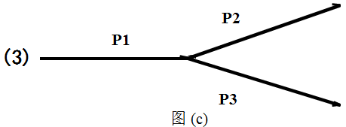

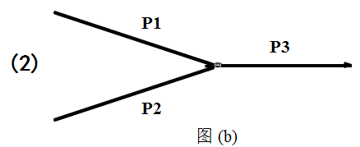
Exercise 2
考虑下面各图中的3个进程 P1, P2, 和 P3.
试定义信号量，通过对这些信号量的wait/signal操作实现进程 P1，P2和P3 的同步，假设P1、P2和P3各自的动作如下：
P1: while(1){ P2: while(1){ P3: while(1){
S1; S3; S5;
S2; S4; S6;
} } }

Slide 48
Answer：
Semaphore: S12=0, S23=0
P1:
while(1){
S1;
S2;
signal(S12);
}
P2:
while(1){
wait(S12);
S3;
S4;
signal(S23);
}
P3:
while(1){
wait(S23);
S5;
S6;
}

Slide 49
Answer：
Semaphore: S13=0, S23=0
P1:
while(1){
S1;
S2;
signal(S13);
}
P2:
while(1){
S3;
S4;
signal(S23);
}
P3:
while(1){
wait(S13);
wait(S23);
S5;
S6;
}

Slide 50
Answer：
Semaphore: S12=0, S13=0
P1:
while(1){
S1;
S2;
signal(S12);
signal(S13);
}
P2:
while(1){
wait(S12);
S3;
S4;
}
P3:
while(1){
wait(S13);
S5;
S6;
}

Slide 51
Exercise 3
阅览室管理问题： 某阅览室共有 100 个座位。 读者想进入阅览室，
若还有空位，则先在登记本上登记(check in)，然后进入阅览室。离开阅览室之前还要注销登记(check out)。
（注意：每次只能有一个读者check in 或者check out）
若阅览室已经没有空位，则读者等待。
要求：用信号量机制解决该问题。

Slide 52
Answer:
假定：没有空位，则读者等待。
1．定义如下两个信号量：
seat=100，用于描述阅览室中当前空闲的座位数量
mutex=1，用于读者互斥地使用登记表
2．读者进程的代码结构如下：
{
check in; // 登记姓名、进入时间等；
阅读；
check out; // 填写离开时间等；
}.

Slide 53
Answer:
假定：没有空位，则读者离开。
1．定义如下共享变量和信号量量：
int seat = 100; // 用于描述阅览室中当前空闲的座位数量
semaphore mutex_seat = 1; // 用于读者互斥地访问变量 seat semaphore mutex_check = 1; // 用于读者互斥地使用登记表
2．读者进程的代码结构如下：
reader(){
if (seat>0) { seat--;
};
else {
exit() };
check in;
reading；
check out;
seat++;
}.

Slide 54
Exercise 4
有一个盘子，可容纳 3 个水果。 父亲向盘子中放苹果，母亲向盘子中放桔子，女儿从盘子中取苹果吃，儿子从盘子中取桔子吃。 他们只能以互斥的方式操作盘子，并且每次只能向盘子中放一个水果，或从盘子中取一个水果。
请设计父亲、母亲、儿子、女儿4个进程，用信号量机制实现他们对盘子的正确操作。
要求：
定义信号量，为信号量赋初值、并说明每个信号量的作用
描述父亲、母亲、儿子、女儿4个进程代码结构

Slide 55
Answer for Exercise 4
1) Semaphores definition:
empty = 3; mutex = 1; apple = 0; orange = 0;
2) Synchronous processes:
father: while (1) {
puts an apple;
};
daughter: while (1) {
takes an apple;
eats apple;
};
mather: while (1) {
puts an orange;
};
son: while (1) {
takes an orange；
eats orange; };

Slide 56
Exercise 4 revised
有一个盘子，只可容纳 1个大苹果或者同时容纳3个小桔子。 父亲向盘子中放苹果，母亲向盘子中放桔子，女儿从盘子中取苹果吃，儿子从盘子中取桔子吃。 他们只能以互斥的方式操作盘子，并且每次只能向盘子中放一个水果，或从盘子中取一个水果。
请设计父亲、母亲、儿子、女儿4个进程，用信号量机制实现他们对盘子的正确操作。
要求：
定义信号量，为信号量赋初值、并说明每个信号量的作用
描述父亲、母亲、儿子、女儿4个进程代码结构

Slide 57
Problems using semaphore
mutual exclusion: All processes share a semaphore variable mutex (initialized 1)
wait(mutex);
…
critical section
…
signal(mutex);
严格遵守使用规则!
√
signal(mutex);
…
critical section
…
wait(mutex);
wait(mutex);
…
critical section
…
wait(mutex);
…
critical section
…
signal(mutex);
wait(mutex);
…
critical section
…
×
×
×
×

Slide 58
Exercise 5
In a system with 2 processors, there are 10 concurrent processes sharing a type of resource based on a semaphore S, if each time,
(a) only one process is permitted to enter its critical section to use the resource, or
(b) at most 3 processes are allowed to enter their critical sections to use the resource,
then answer the following questions.
(1) what are the maximum, and minimum numbers of processes in ready, running, and waiting state?
(2) in these two cases, what are the initial, maximum, and minimum values for the semaphore S respectively?

Slide 59
Answer:
(1) the maximum, and minimum numbers of processes in ready, running, and waiting state:
(2) the initial, maximum, and minimum values for the semaphore S respectively:

Slide 60
6.7 Monitors
High-level synchronization construct that allows the safe sharing of an abstract data type among concurrent processes.
Monitor is a software module.
Chief characteristics
Local data variables are accessible only by the procedures within monitor.
Process enters monitor by invoking one of its procedures.
Only one process may be executing in the monitor at a time.

Slide 61
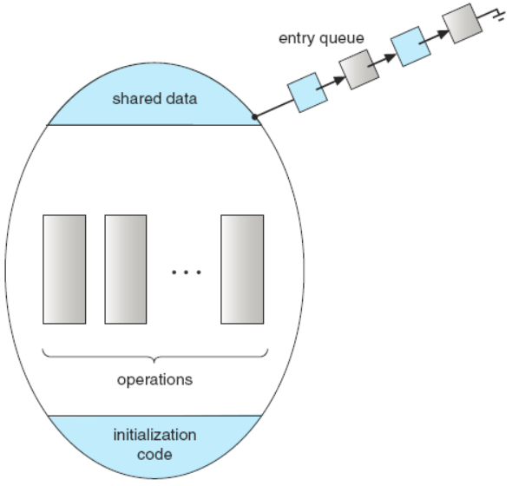
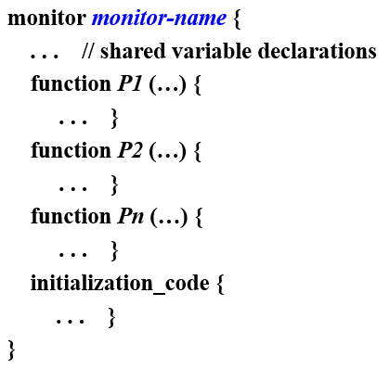
Schematic View of a Monitor

Slide 62
Condition Variable and Operations on It
To allow a process to wait within the monitor, a condition variable must be declared, as
condition x, y;
Condition variable can only be used with the operations wait() and signal().
x.wait(); The process invoking this operation is suspended until another process invokes x.signal();
x.signal(); Resumes exactly one suspended process. If no process is suspended, then the signal operation has no effect.

Slide 63
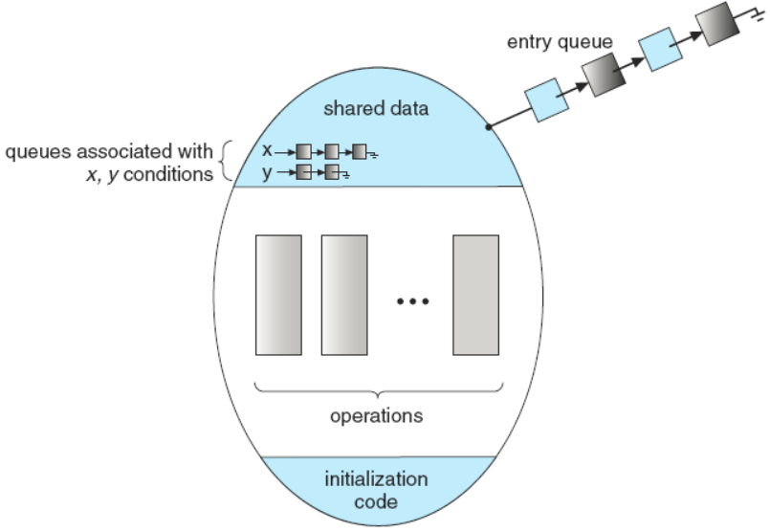
Monitor With Condition Variables
Q: suspended associated with x
P: x.signal( )
--- ???
Q
(1) P waits
until Q leaves the monitor,
for another condition.
(2) Q waits
until P leaves the monitor
for another condition
Solution:
(1) Signal and wait
(2) Signal and continue

Slide 64
Monitor Solution to Dining-Philosophers
monitor dp {
enum {thinking, hungry, eating} state[5];
condition self[5];
void pickup(int i) {
state[i]=hungry;
test[i];
if (state[i]!=eating)
self[i].wait();
}
void putdown(int i) {
state[i]=thinking;
test((i+4)%5);
test((i+1)%5);
}
void test(int i) {
if ( (state[(i+4)%5]!=eating) && (state[i]==hungry) && (state[(i+1)%5]!=eating))
{ state[i]=eating;
self[i].signal();
}
}
void initialization_code() {
for (int i=0; i<5; i++)
state[i]=thinking;
}
}
while(true) {
dp.pickup(i);
… // eating
dp.putdown(i);
… // thinking
}

Slide 65
Monitor Solution to Bounded Buffer Problem
monitor bb {
char buffer[N];
int nextin, nextout;
int count;
condition full, empty;
void append (char x) {
if (count==N)
empty.wait();
buffer[nextin]=x;
nextin=(nextin+1)%N;
count++;
full.signal();
}
void take (char x) {
if (count==0)
full.wait();
x=buffer[nextout];
nextout=(nextout+1)%N;
count--;
empty.signal()
}
void initialization_code() {
nextin=0;
nextout=0;
count=0;
}
}
void producer() {
char x;
while (true) {
/* produce an item in x */
…
bb.append(x);
}
}
void consumer() {
char x;
while (true) {
bb.take(x);
… // consume
}
}

Slide 66
Exercise 6
某应用有三个进程，C、M、和P。
数据采集进程 C 把采集到的数据放到buf1中。
数据处理进程 M 从buf1中取数据进行处理，并把结果放入buf2中。
数据输出进程 P 从buf2中取出结果打印输出。
考虑以下两种情况，用信号量机制实现进程C、M、和
P之间的同步，分别给出进程C、M、和P的代码结构
(1) Buf1、buf2都只能保存一个数据
(2) Buf1可以保存m个数据、buf2可以保存n个数据
（假设各进程对缓冲区的操作需要互斥）

Slide 67
Exercise 7
某工厂有一条生产线，其上可以放置10个零件。有三个工人小张、小王和小李。
小张每次生产1个零件A，并放置到生产线上；
小王每次生产1个零件B，并放置到生产线上；
小李每次从生产线上取1个A和2个B，组装产品C。
工人们不能同时使用生产线取放零件。
请用信号量机制实现三个工人进程，确保流水线能够正常工作。
（1）定义信号量及变量，给出其初值，说明其作用
（2）写出三个工人进程的代码结构

Slide 68
Exercise 8
某系统中有m个进程并发执行，分为A、B两组，他们共享文件F，A组进程对文件F进行写操作，B组进程对文件F进行只读操作。写操作需要互斥进行，读操作可以同时发生，即当有B组的某进程正在对文件F进行读操作时，若没有A组的进程提出写请求，则B组的其他进程可以同时对文件F进行读操作，如果有A组的进程提出写请求，则阻止B组的其他进程对文件F进行读操作的后续请求，等当前正在读文件的B组进程全部执行完毕，则立即让A组提出写请求的进程执行对文件F的写操作。
（1）定义信号量及变量，给出其初值，说明其作用
（2）写出A组和B组进程的代码结构

Slide 69

课后作业及研究性学习
作业
掌握操作系统进程同步机制
实验（二选一）
编码实现“生产者-消费者”问题；
编码实现“读者-写者”问题。
研究性学习
查阅wait与signal操作的源码；
总结解决临界区问题的可行方案。
A1: openEuler
进程互斥
A2: openEuler
信号量机制
A3: openEuler 内存屏障

Slide 70
A1: openEuler 进程互斥
openEuler 进程互斥
互斥锁
自旋锁
NUMA-Aware Qspinlock

Slide 71
openEuler 进程互斥
控制中断
ARMv8架构中，寄存器DAIF用于屏蔽中断与异常
标志位I：1—屏蔽中断，0—打开中断
操作数ADIFset，将DAIF相应位置1；
操作数ADIFclr，将DAIF相应位清0；
指令MSR，将操作数ADIFset与ADIFclr第2位置1，实现将DAIF的中断屏蔽位I置1与清0.
寄存器DAIF的值在屏蔽中断之前保存，打开中断之前恢复。
raw_local_irq_save(flags)
Raw_local_trq_restore(flags)
arch_local_irq_disable(void)
<临界区>
arch_local_irq_enable(void)

Slide 72
互斥锁
锁：经常使用的实现互斥的原语
本质：内存中的共享变量
0—空闲可用，1—（已加锁）不可用
操作：lock() / unlock()，原子操作
ARMv8的独占访问指令
LDXR <Xx>, [<Xn | SP > {, #0}] 从内存地址取出数据放到寄存器Xx，然后将此地址标记为独占。
STXR <Xs>, <Xt>, [<Xn | SP > {, #0}] 检查访问的地址是否被标记为独占， 是，将寄存器Xt的值写入该地址中，清除独占标识，返回一个写入成功的标志值0到寄存器Xs； 不是，不将Xt的值写入地址，返回写入失败标志值1到寄存器Xs。
多核环境中，配套使用具有强大的功能，提高系统工作效率。

Slide 73
互斥锁
CAS(Compare And Swap)指令
CAS <Xs>, <Xt>, [<Xn | SP > {, #0}]
原子操作：读取-比较-写入
从内存中读出数据，将其与Xs的值进行比较， 相等，将Xt的值写入内存，同时，将内存中的原值写入Xs； 不等，直接将内存中的原值写入Xs。
执行结束后，比较Xs的最新值与Xs的原值 相等，内存数据得到更新； 不等，内存数据没有变化。
CAS执行期间，内存不会被其他操作修改。
使用CAS实现加锁操作，原子地对锁终态进行检测和设置。
锁的期望值0➔Xs，锁的更新值1➔Xt
执行后，若Xs=0，则线程已经获取锁，否则，获取失败，需等待

Slide 74
互斥锁
CAS (Cont.)
openEuler利用CAS实现了一个加锁函数__cmpxchg_case_##name()
LDXS/STXR与CAS对比
若CPU数量少，或者锁竞争不激烈： LDXS/STXR对总线的竞争页比较少，性能比CAS好； 移动设备上，优先使用LDXS/STXR。
在多核多并发且跨NUMA的场景下，CAS能够提升获取锁的性能。 如在服务器上，CPU核数众多（鲲鹏920，64核），还支持NUMA系统，如果多条LDXS/STXR指令并发执行，则冲突概率加大，导致获取锁的成功率降低；基于CAS能够保证对总线的有序访问，锁的成功率与并发数无关，仍可达100%。
openEuler提供一个内核参数lse进行选择，默认为on，即选择cAS.

Slide 75
自旋锁
Linux内核最常见的锁机制
基本思想
若临界区中有进程，则其他请求获取锁的进程
在进入区循环读取锁的终态，直到获取到锁。——自旋锁
openEuler将枷锁函数__cmpxchg_case_##name()封装为函数atomic_cmpxchg_acquire()使用。
自旋锁会带来严重的性能开销。 如，某线程，获取锁之后，进入临界区之前，CPU被抢占，若采用RR调度算法，其他线程想获取该锁，开始自旋，直到时间片用完，其他想获得该锁的进程有同样的问题。 导致：资源浪费：消耗CPU周期，消耗总线和存储器带宽等。
自旋锁并不保证等待线程获取锁的公平性。——饥饿

Slide 76
自旋锁： Qspinlock
Qspinlock：队列自旋锁，openEuler内核的锁机制
引入队列，当锁释放时，施加规则，决定哪个线程抢到锁
引入一个本地锁，线程根据本地锁的终态判断其是否位于队列的队首。只有位于队首的线程才能读取全局的锁终态。
两阶段锁，
锁处于可获取终态，线程直接获得锁。
锁被其他线程持有，但没有其他等待线程，该线程以自旋的方式不断尝试获取锁；否则，将锁的获取过程分为两个阶段：
阶段1：等待线程进入休眠，直到其排到队首时被唤醒；
阶段2：等待线程以自旋的方式不断尝试获取锁

Slide 77
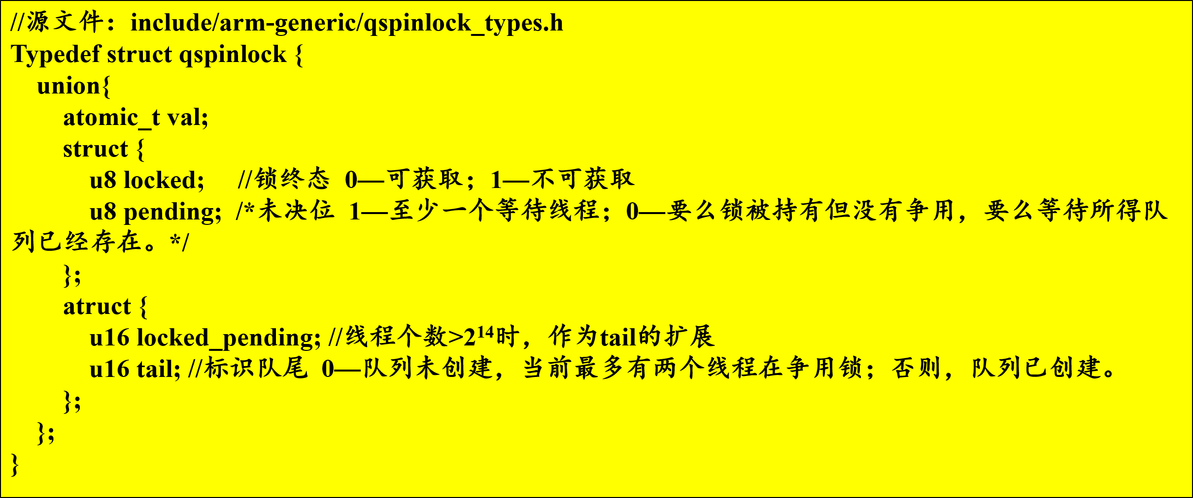
自旋锁： Qspinlock
Qspinlock概况

Slide 78
自旋锁： Qspinlock
使用三元组（tail, pending, locked）描述Qspinlock锁的状态。
获取锁的快速路径
当第1个线程T1尝试获取锁时，T1先访问当前锁的状态，检测锁状态lock->val的值是否为0.
为0，T1直接获取锁，并将锁的状态（locked）置1；三元组状态更新为（0，0，1）
不为0，进入慢速路径中，等待锁的持有者释放锁。

Slide 79
自旋锁： Qspinlock
慢速路径：第2个线程试图获取锁
在queued_spin_lock_slowpath()中检查是否存在其他线程正在争用锁。 对T2而言，pending与tail的当前值均为0，没有争用。
T2将字段pending置1，三元组更新为（0，1，1） T2以自旋的方式读取状态lock->val，以等待锁的释放。
若T1释放锁，T2将退出函数 atomic_cond_read_acquire() 的循环。 三元组更新为（0，1，0）。
T2直接获得锁；并将pending清0；将locked置1.
三元组更新为（0，0，1）
当pending的值为1，T2在自旋等待锁，如有其他线程试图获取锁，则将被推入一个FIFO队列。

Slide 80
自旋锁： Qspinlock
慢速路径：排队，FIFO
为保证获取锁的公平性，在Qspinlock中采用MCS（以发明者的名字命名）队列来管理多个试图获取锁的线程。
MCS节点的数据结构：
Next：指向后继节点
Locked：用于判断当前节点是否是队首
Count：记录当前CPU获取锁的个数，一个CPU至多可同时获取4个锁，（嵌套锁）。
//源文件：kernel/locking/mcs_spinlock.h
Struct mcs_spinlock {
struct mcs_spinlock * next;
int locked;
int count;
}

Slide 81
自旋锁： Qspinlock
慢速路径：排队，FIFO
openEuler规定一个CPU在一种类型的中断中至多只能尝试获取一个锁
除了线程本身可以试图获得一个锁外，还有三个中断事件，即softirq、hardirq、NMI也能试图获取锁。
每个CPU共定义4个MCS节点，保存在CPU的qnode数组中。
只有争用锁的线程大于两个，才会启用MCS队列。
T1持有锁，T2在自旋
T3到来，被推入MCS队列
首先，T3通过qnode[0]得到当前CPU被竞争的锁的数目count，并将count加1，表示在qnode[]数组中即将获取的空闲node的索引； 其次，T3将自己的CPU编号和context编号编码进变量tail里。 最后，取出对应的空闲MCS节点node，并初始化，将其locked置0，next置NULL。

Slide 82
自旋锁： Qspinlock
慢速路径：排队，FIFO
位于队首的T3循环读取pending与locked的值，检测它们是否都为0来自旋等待T2获取锁后，线程T2释放锁。
T3排队时，T4到来，T4被推入MCS队列，排在队尾。
为减少性能消耗，操作系统让当前CPU进入休眠状态。

Slide 83
自旋锁： Qspinlock
ARMv8中，使CPU进入休眠状态的命令wfe
函数wfe()中封装了指令wfe(wait for event)
只有当锁被T3释放时，使用sev(send event)，该CPU才会被唤醒，并再次尝试获取锁。
在MCS队列中，当位于队首的线程可以获取锁时，有以下两种情况：
如果该线程是MCS队列中唯一的排队者，可直接获取锁并清楚tail，并释放MCS节点。
如果在MCS队列中还存在其他排队者，队首节点优先获取锁，在调用函数smp_cond_load_relaxed()将后继节点next->locked置1，并将后继节点对应的CPU唤醒。 后继节点成为队首节点，并自旋等待qspinlock锁的释放。
Qspinlock的解锁比较简单，只需将locked置0即可。

Slide 84
NUMA-Aware Qspinlock
NUMA感知队列自旋锁
在NUMA中，openEuler采用CNA队列代替MCS队列
CNA，Compact NUMA-Aware lock，紧凑NUMA感知锁
CNA将等待获取锁的线程组织为两个队列
主队列，其中的线程与主队队首线程运行在相同的NUMA节点上
辅助队列，其中的线程与主队队首线程运行在不同的NUMA节点上
当一个线程试图获取CNA锁时，它将先被加入主队列；
当锁被释放时，与队首不处于同一个NUMA节点的线程可能被移动到辅助队列。

Slide 85
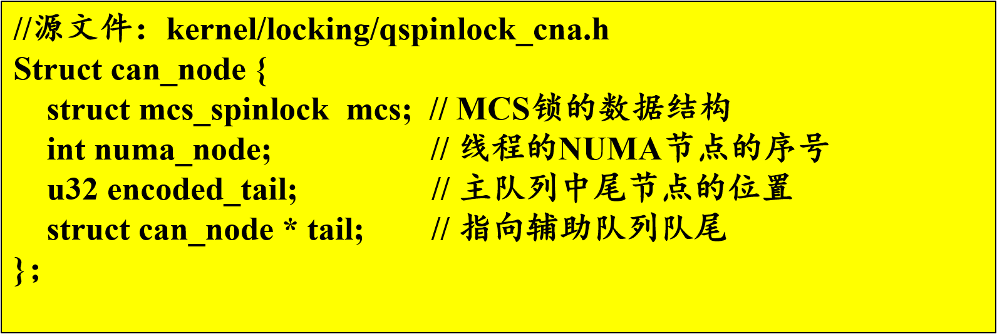
NUMA-Aware Qspinlock
主要数据结构
mcs, 其中记录锁的状态locked和指向下一个MCS节点的指针next
encoded_tail, 由节点的CPU编号与context编号编码而成，

Slide 86
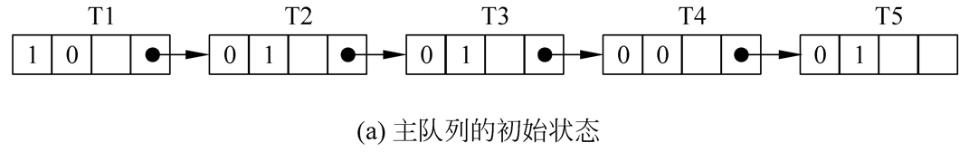
NUMA-Aware Qspinlock
CNA排队示意
CNA的主要成员：
主队列初始状态：
T1位于NUMA0上。在队首，自旋等待获取锁
当T1成功获取锁，则遍历主队列以寻找队首继承者
队首继承者，即下一个持有者（next_holder）
由于T4也在NUMA0上，T4成为队首的继承者
T1将T4的锁状态locked置1，使其成为了主队队首
T2和T3将被加入到辅助队列

Slide 87
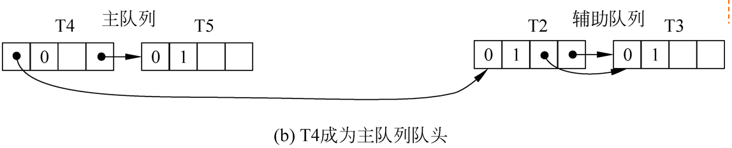
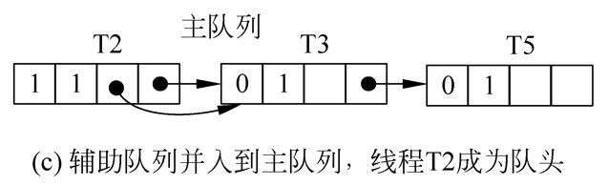
NUMA-Aware Qspinlock
T4成为主队列队首，T2成为辅助队列队首
当T4成功获取锁时，其遍历主队列寻找继承者
没找到，辅助队列的节点被并入主队列，T2为队首

Slide 88
NUMA-Aware Qspinlock
cna_pass_lock()函数
在辅助队列为空，且当前锁的争用较低时，直接选择后继节点为继承者；
如果位于同一个NUMA节点的线程频繁地发出获取锁的请求，CNA可能长时间地仅处理本地线程的请求，导致其他NUMA节点上的线程长时间空等。
控制主队列获取锁的概率，定期地将都主队列中的节点并入主队列中。
如果主队列的队首无法在主队列中找到继承者，CNA则将辅助队列中的节点并入主队列中。
并入过程
将辅助队列的队首作为继承者，并将主队列的尾节点插入到辅助队列的尾节点之后
将继承者的成员遍历locked置1.

Slide 89
NUMA-Aware Qspinlock
cna_try_find_next()函数
在寻找继承者的过程中，对主/辅队列的更新：
方案1：遍历主队列的过程中，将不是继承者的节点移出主队列，推入辅助队列。
方案2：找到继承者之后，一次性对主/辅队列进行更新，CNA采用此方案。
用变量first和last分别记录第一个和最后一个非继承者节点
更新主队列，将继承者变为主队列队首节点的后记节点，即将队首节点的成员变量cn->mcs.next指向last->mcs.next。
更新辅助队列， 若辅助队列为空，创建辅助队列，即将辅助队列的尾指针指向last，将主队列队首节点的成员变量cn->mcs.locked指向first->encoded_tail； 若辅助队列不空，从主队列的队首节点的成员变量cn->mcs.locked中取出一个指向辅助队列队首的指针，并将first指向的节点插入到辅助队列队尾，同时将辅助队列的尾节点更新为last指向的节点。

Slide 90
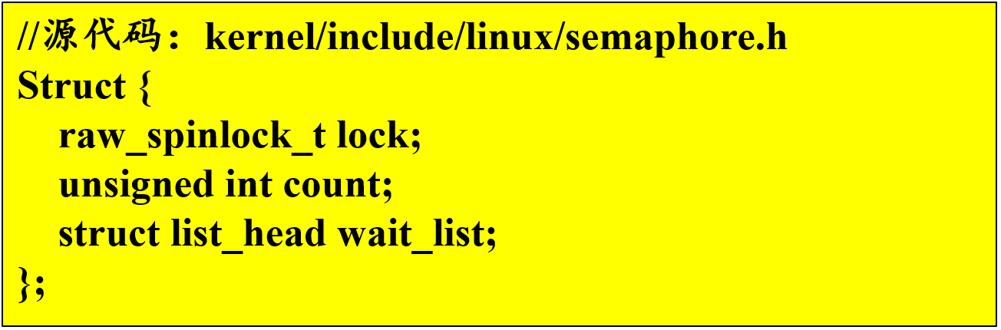
A2: openEuler 信号量机制
down原语和up原语
down原语在函数down()的基础下提供了多个变种函数
信号量的数据结构
count，共享的资源数量
wait_list，指向信号量等待队列
lock，保护对count和wait_list的互斥访问

Slide 91
openEuler 信号量机制
down原语的实现
为保证down操作的原子性，线程将整个down操作上锁，操作结束后释放锁。
线程判断当前可用资源数量
>0，sem->count的值减1，成功获得资源
否则，获取资源失败，进入函数__down_interruptible()进行处理
函数__down_interruptible()的主要处理再函数__down_common()中实现
将获取资源失败的线程加入到信号量等待队列队尾；
将该线程的状态更新为：waiting；
主动让出CPU，等待信号量的释放；
结构体变量waiter用来描述被推入等待队列的线程，其成员变量up用作唤醒标志
当前线程被推入等待队列后，waiter.up置为false；
当waiter.up=true时，表明该线程已经被唤醒。
Waiter.up的值的改变在up原语中实现。

Slide 92
openEuler 信号量机制
up原语的实现
当前线程判断在等待队列sem->wait_list中是否有阻塞线程
没有，释放资源，sem->count加1；
有，唤醒等待队列中的某个线程 为保证公平性，采取FIFO原则。
唤醒过程
当前线程将阻塞线程移出等待队列
将阻塞线程的waiter->up修改位true，即唤醒该线程；
修改线程状态为ready，将其加入ready队列。

Slide 93
A3: openEuler 内存屏障
内存屏障
现代CPU对程序执行的影响
内存屏障指令
插入内存屏障指令
鲲鹏处理器内存屏障指令
openEuler内核中内存屏障接口
内存顺序模型
openEuler中内存屏障的应用

Slide 94
内存屏障
适用于现代CPU架构的同步机制。
作用：
解决指令乱序执行带来的问题；
用于在多个CPU核上并发执行的进程组之间的同步。
做法：
通过禁止内存屏障前后指令的乱序执行，确保多个CPU核在共享内存时语义的准确性。
乱序执行（out-of-oeder Execution）
指令执行的顺序被打乱，不一定按照软件中规定的顺序执行。
目的：
现代CPU利用流水线技术，在一个时钟周期内执行多条指令以节省等待时间，提高运行时性能。
找出没有依赖关系的指令，打乱它们的执行顺序。

Slide 95
现代CPU对程序执行的影响
a=1;
b=2;
c=3;
flag=true;
while(flag) {
call_func(a, b, c);
return;
}
CPU0:
a=1;
b=2;
c=3;
flag=true;
CPU1:
while(flag) {
call_func(a, b, c);
return;
}
CPU0:
a=1;
b=2;
flag=true;
c=3;
CPU1:
while(flag) {
call_func(a, b, c);
return;
}
单核：ok
多核：？
解决方案
禁止CPU乱序执行；
提供同步机制，使得某些指令执行前必须完成前面指令的执行。

Slide 96
内存屏障指令
作用：禁止内存屏障指令前后指令的乱序执行。
实现：
在程序中插入内存屏障指令。
乱序执行时：
CPU先将获取的指令发送到一个执行缓存区，指令等待直到可获取该指令的运算对象。
后放入缓存区的指令可能先执行。
CPU获取到内存屏障指令，将不再把内存屏障指令核后续的指令放入缓存区，等之前的指令全部执行完之后，再将内存屏障指令核后续的指令放入缓存区。

Slide 97
插入内存屏障指令
CPU0:
a=1;
b=2;
c=3;
memoey_barrier();
flag=true;
CPU1:
ready=flag;
memoey_barrier();
while(ready) {
call_func(a, b, c);
return;
}

Slide 98
鲲鹏处理器内存屏障指令
DMB(Data Memory Barrier, 数据内存屏障)指令
保证指令DMB之前的内存访问都完成后，其后的内存访问指令才能开始执行。
其他非内存访问指令可以乱序执行。
DSB(Data Synchronization Barrier, 数据同步屏障)指令
保证DSB之前的内存访问指令、缓存维护指令、页表缓存维护指令完成之后，DSB之后的指令才能开始执行。
ISB(Instruction Synchronization Barrier, 指令同步屏障)指令
保证ISB之前的命令全都执行完成后，ISB之后的指令才会重新从cache或内存取指。
常用于发生异常，异常返回或者更改系统配置寄存器的场景下。

Slide 99
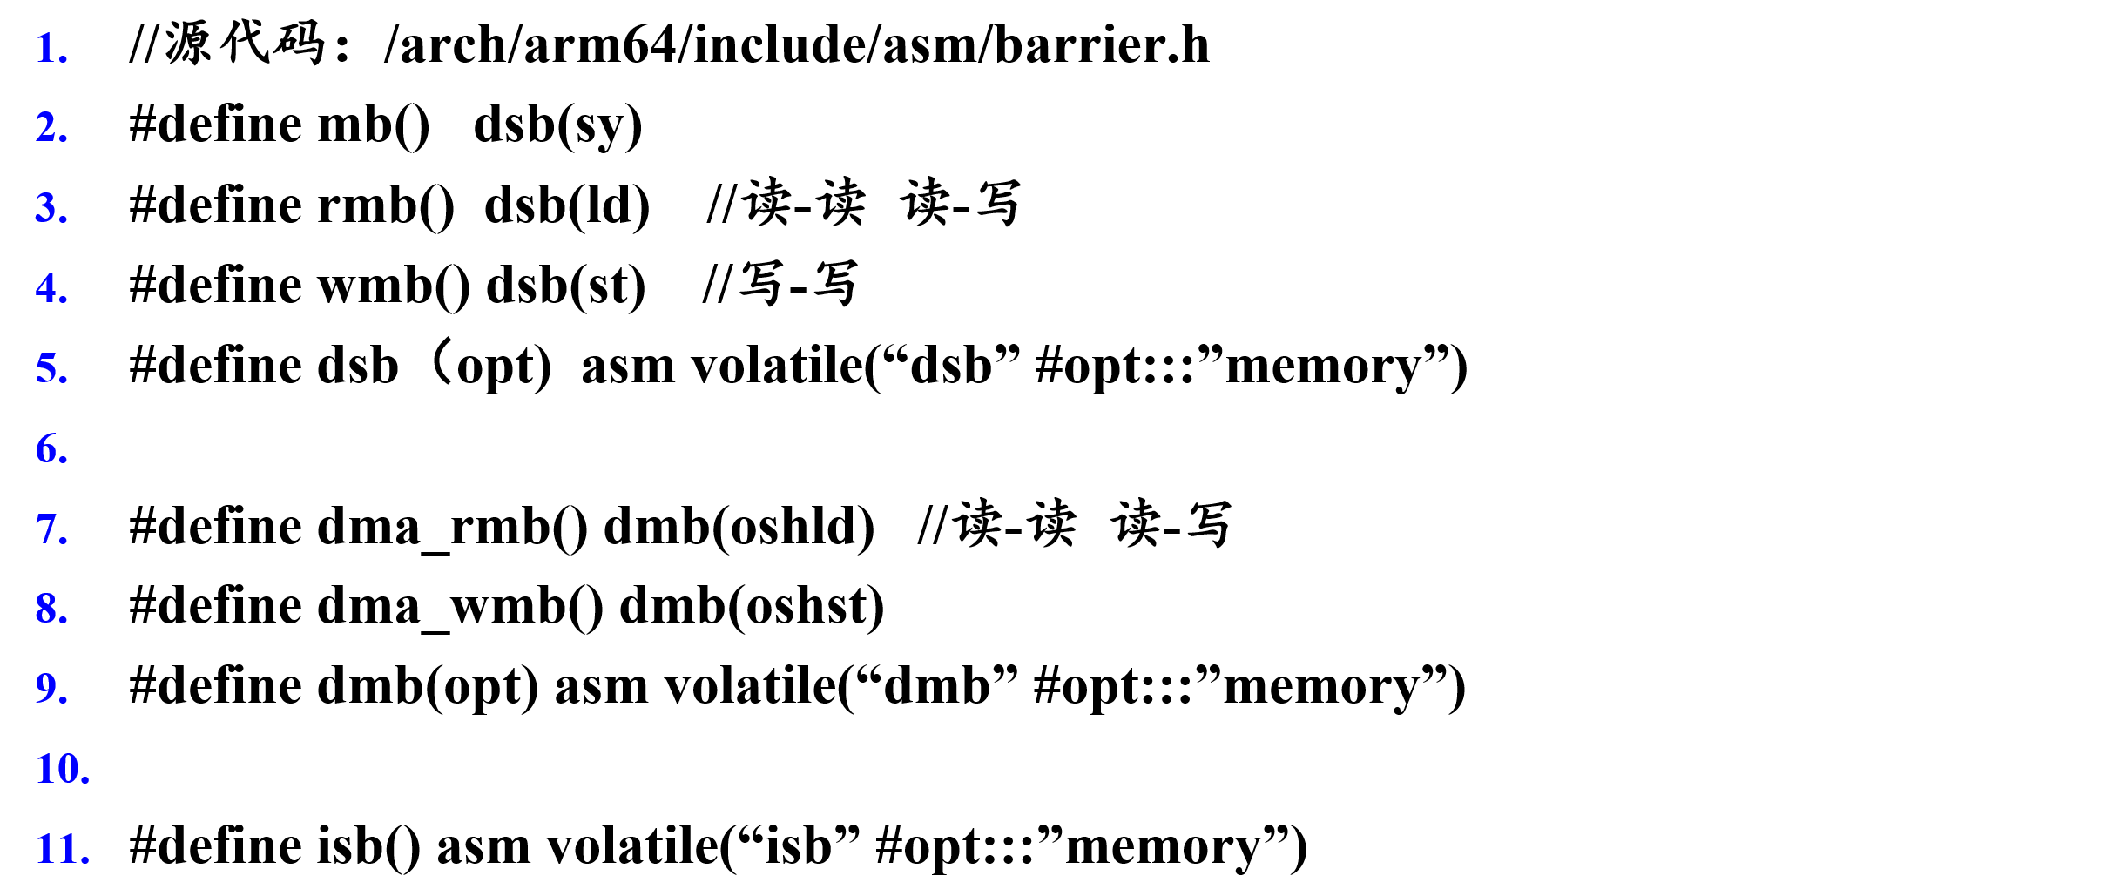
openEuler内核中内存屏障接口

Slide 100
内存顺序模型
绝对顺序模型
禁止所有优化导致的乱序执行
所有内存访问指令串行排队执行
强内存顺序模型
代表： x86
只允许store-load（即先执行store指令，再执行load指令）乱序执行
弱内存顺序模型
代表：ARM
允许所有情况下的指令乱序执行
在不同CPU架构之间移植代码时，需注意两种架构之间内存顺序模型的异同。
从x86向ARM移植代码时，需要注意添加内存屏障。
建议：在所有需要插入内存屏障的位置调用内存屏障接口

Slide 101
openEuler中内存屏障的应用
kfifo队列
结构体_kfifo的定义
数据入队操作
写数据
更新写指针in
读数据操作
读数据
更新读指针out
写操作乱序执行将出错
在写/读数据之后，调用内存屏障接口
//源代码：kernel/include/linux/kfifo.h
struct __kfifo {
unsigned int in; //写指针
unsigned int out; //读指针
unsigned int mask; //队列容量
unsigned int esize; //元素大小
unsigned int * data; //队列起始位置
}

